Slide 1
Artificial Intelligence Day 1

Slide 2
Artificial Intelligence vs. Machine Learning
Often used interchangeably, but this is incorrect
Artificial Intelligence is the broader category that encompasses machine learning, natural language processing, neural networks, computer vision, etc
Machine learning is a subset of artificial intelligence, a field of study that uses algorithms to gain insights and recognize patterns in data

Slide 3
A general (incomplete) list of fields of Artificial Intelligence
Machine Learning: use of algorithms to gain insights and recognize patterns in data, gives machines the ability to perform a task without explicitly being programmed to do so.
Neural Networks: really a branch of machine learning that teaches computers to process data in a way that is inspired by human brains. The use of artificial neurons, for example, is one aspect of neural networks
Deep Learning: a branch of machine learning that leverages neural networks as its backbone to perform machine learning tasks. Deep learning uses a neural network of at least three layers.
Natural Language Processing (NLP): an interdisciplinary field of research (computer science & linguistics) that is tasked with getting computers to support and use human language. Not all forms of NLP rely on machine learning, but many now do.
Large Language Models like GPT-3 and GPT-4 are examples of NLP tech that rely on machine learning.
Computer Vision: enables machines to identify, analyse, and interpret visual input from images(and video).
Generative AI: combines several algorithms encompassing a generative model to create new content like text, images, video, etc.. Examples: OpenAI's ChatGPT & Dall-E
Artificial General Intelligence: a hypothetical type of agent that could perform any form of intellectual task just as well, or better, than human beings. The study of AGI is a field in theoretical computer science.

Slide 4
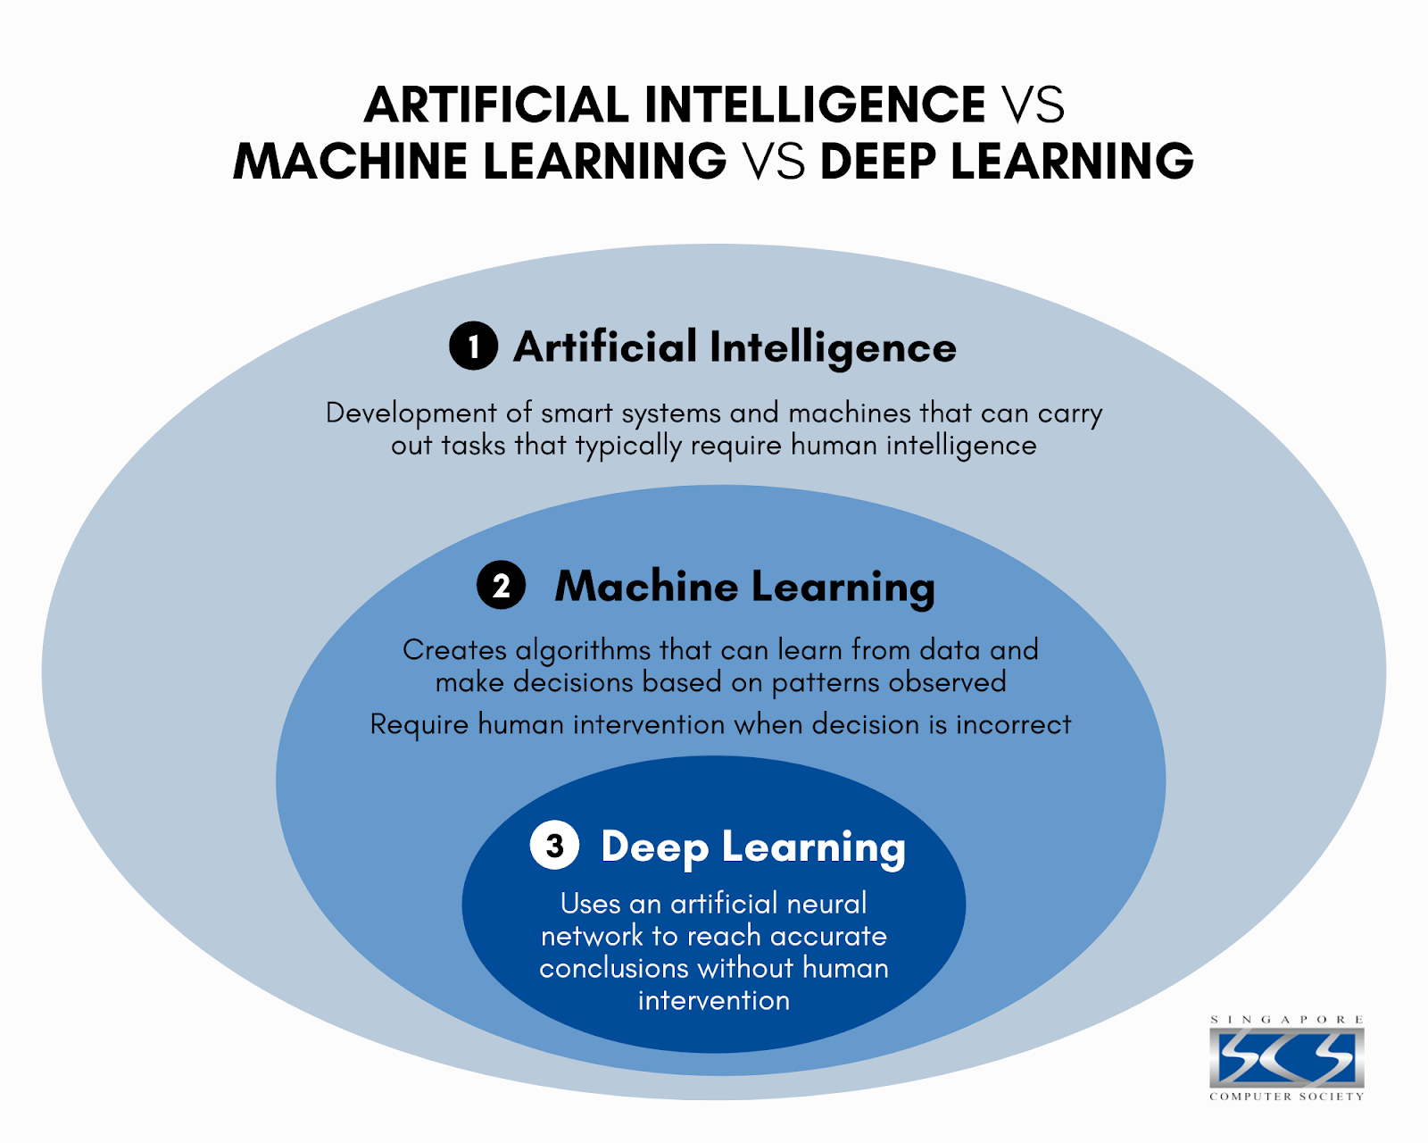
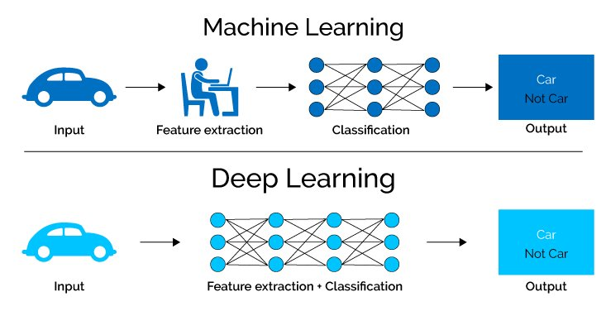

Slide 5
Important vocabulary for talking about machine learning
Model: A representation or abstraction of a system that we want the machine to learn.
Algorithm: A set of rules or instructions that the machine follows to perform a task.
Data: Information used by the machine learning model to learn patterns and make predictions.
Features: The individual input variables or attributes used by a model to make predictions.
Label/Target: The output variable or the value that the model is trying to predict.
Training Data: The portion of the overall data used to train the machine learning model.
Testing/Validation Data: The portion of the data used to evaluate the performance of the trained model.
Inference: When the model makes predictions on new data given what it calculates

Slide 6
More vocab
Bias: refers to the error introduced by approximating a real-world problem, which may be extremely complex, by a simplified model. It can lead to systematic errors in predictions.
Variance: measures the model’s sensitivity to variations in the training data. High variance can lead to overfitting, while low variance can result in underfitting.
Hyperparameter : Configuration settings that are external to the model and are not learned from the data. They are set before the training process and can significantly impact the model’s performance.
Dimensionality Reduction: Involves reducing the number of input features in the data while preserving its essential information. This can help improve model efficiency and reduce overfitting.
Cross-Validation :A technique used to assess a model’s performance by splitting the data into multiple subsets, training the model on some subsets, and testing it on others to ensure robustness.
Accuracy :A measure of a model’s overall correctness, calculated as the ratio of correctly predicted instances to the total instances.
Precision: A measure of a model’s accuracy in predicting positive instances, calculated as the ratio of true positive predictions to the total predicted positive instances.
Recall :A measure of a model’s ability to identify all relevant instances, calculated as the ratio of true positive predictions to the total actual positive instances.
F1 Score :A metric that combines precision and recall, providing a balance between the two and is especially useful when dealing with imbalanced datasets.

Slide 7
Supervised vs. Unsupervised Learning
Supervised learning: A type of machine learning where the model is trained on a labeled dataset, meaning the algorithm learns from input-output pairs. Generally, this is task driven.
Unsupervised learning: A type of machine learning where the model is given unlabeled data and must find patterns or relationships on its own. Generally, this is data driven.
Semi-supervised learning: A hybrid approach that uses both labelled and unlabelled data. This is good when you have a lot of data, but you can't possibly label all of it, but labelling even a portion of it dramatically improves the quality. Example: medical scans

Slide 8
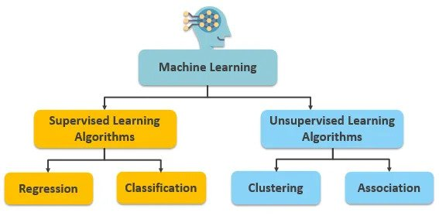

Slide 9
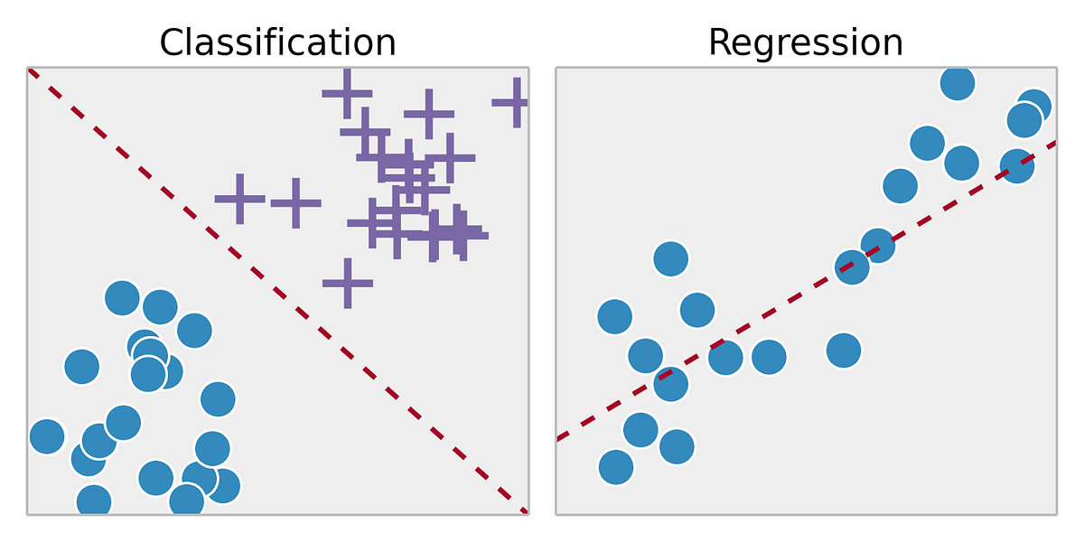
Types of supervised learning
Classification: A type of supervised learning where the model predicts a discrete category or label. (Discrete)
Regression: A type of supervised learning where the model predicts an output. (Continuous)

Slide 10
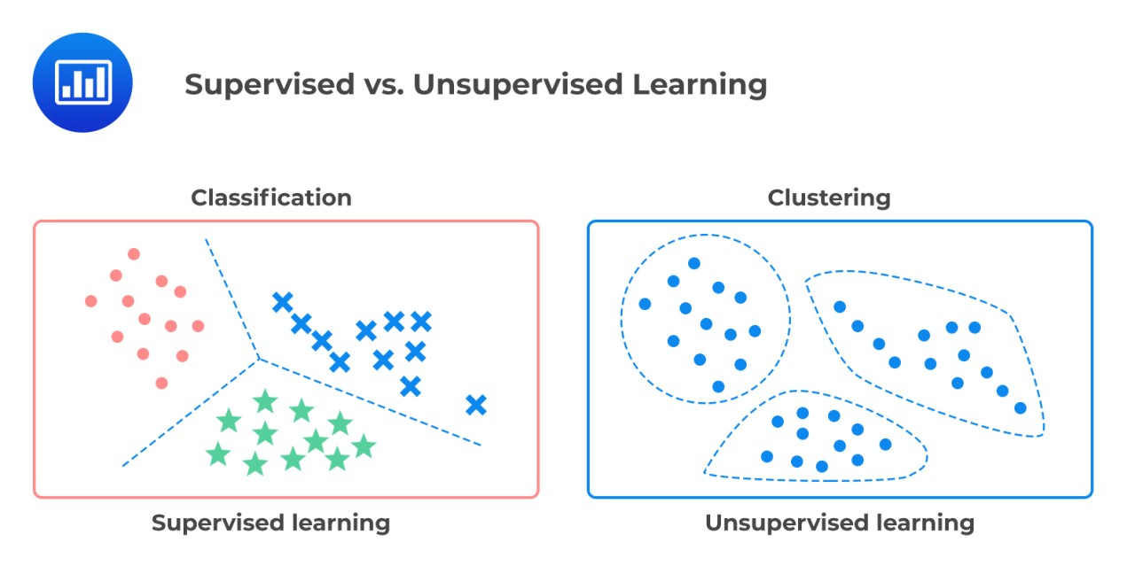
Types of unsupervised learning
Clustering: An unsupervised learning technique where the goal is to group similar data points together based on certain characteristics. (Discrete)
Association Rule Mining: a technique used to uncover relationships between different items or variables in a dataset. The primary focus is on identifying sets of items that frequently occur together. (Discrete)

Slide 11
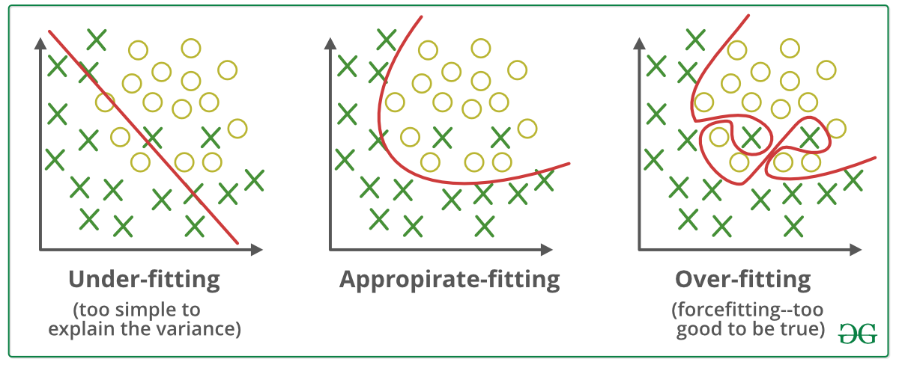
Overfitting and underfitting
Overfitting: When a model learns the training data too well and performs poorly on new, unseen data.
Overfitting: When a model learns the training data too well and performs poorly on new, unseen data.

Slide 12
General steps for supervised learning
Define the problem you are trying to solve
Collect & prepare the data
Gather a dataset. Ensure the data is clean, free of errors, and representative of the problem you're trying to solve.
Explore and pre-process the data
Analyze the data to understand its characteristics and distribution. Handle missing values, outliers, and perform any necessary feature scaling or normalization.
Identify the input characteristics of the training dataset & label your data.
You will likely have to label the data yourself if you find data in the wild. The exemption is you use pre-labelled data.
Split the dataset into training and testing sets.
Feature engineering/Dimensionality Reduction
Select, transform, or create new features that enhance the model's ability to make accurate predictions. This step is essential for improving model performance.
Choose an algorithm
Train the model
Tune the model
Fine tune the hyperparameters in the model to better make predictions
Assess the model's performance on the testing set using appropriate evaluation metrics.
Make predictions on new data

Slide 13
General steps for unsupervised learning
Define the problem
Collect and prepare the data
Explore and pre-process the data
Dimensionality Reduction (if applicable)
If the dataset is big, consider applying dimensionality reduction techniques to simplify the data while preserving essential information.
Feature scaling (if applicable)
Standardize or normalize features if the algorithm being used is sensitive to the scale of the input features.
Choose an Unsupervised Learning Algorithm
Select an algorithm based on the nature of the problem and the desired outcomes.
Train the model (this doesn't mean labelling, rather iterate)
Tune the model (if applicable).
Explore results and patterns
Visualization (if applicable)
Sometimes we want to represent our data in lower-dimensional spaces to display the clustering effects for example
Make predictions

Slide 14
Common Pre-Processing Steps for both supervised and unsupervised learning
Data cleaning
Data scaling/normalization
Handling of categorical data (Female -> 0, Male ->1)
Feature engineering
Dimensionality reduction
Data splitting
Handling Time Series Data:
Time series data has temporal dependencies that require specific considerations.
Handling of redundant features
Redundant features can introduce multicollinearity, affecting the stability of models like linear regression

Slide 15
Algorithms for dimensionality reduction
Linear
Principal Component Analysis (PCA)
Linear Discriminant Analysis (LDA)
Random Projection
Non-Linear
t-Distributed Stochastic Neighbor Embedding (t-SNE)
Uniform Manifold Approximation and Projection (UMAP)
Isometric Mapping (IsoMap)
Autoencoders
Kernel PCA
Locally Linear Embedding (LLE)

Slide 16
Classification-tasked supervised learning models
Naive Bayes:
Applies Bayes' theorem with the assumption that features are conditionally independent, often used for text classification and spam filtering.
Linear Discriminant Analysis (LDA):
A method for finding linear combinations of features that best separate different classes in a dataset.
Logistic Regression:
Used for binary classification
Despite regression in the name, this algorithm determines the probability that an instance belongs to a particular class. It defines outputs in 1s or 0s, True or False as it is a binary classifier.

Slide 17
Regression–tasked supervised learning models
Linear Regression:
Predicts a continuous output based on linear relationships between input features and the target variable.
Example: Ordinary Least Squares Algorithm
Ridge Regression and Lasso Regression:
Ridge regression and Lasso regression are extensions of linear regression that introduce regularization terms. They help prevent overfitting and handle multicollinearity by adding regularization penalties to the linear regression objective function.
Examples: Lasso/L1 Regularization, Ridge Regression/Tikhonov Regularization
Bayesian Linear Regression
Generally tasked with regression, but can be adapted for classification
Polynomial regression
Good for silencing noise and finding what order of magnitude to use in your model

Slide 18
Algorithms that can do both classification or regression for supervised learning
K-Nearest Neighbors: An instance-based algorithm that predicts the class based on the majority of neighbors for classification or the average of neighbors for regression.
Kernel Methods: Algorithms that operate in a high-dimensional feature space using kernel functions
Support Vector Machines (SVMs): A powerful algorithm that finds a hyperplane to separate classes in classification or predict continuous values in regression.
Neural Networks: Deep learning models composed of interconnected nodes organized into layers, capable of learning complex patterns for both classification and regression tasks.
Elastic Net Regression
Uses Lasso(L1) and Ridge (L2) regularization mentioned in regression before, but suitable for classification too.

Slide 19
Algorithms that can do both classification or regression for supervised learning (continued)
Ensemble Methods:
Ensemble methods are a machine learning approach that involves combining the predictions of multiple individual models to improve overall performance and generalization. The idea is to harness the collective intelligence of diverse models to achieve better results than any individual model
Decision trees: Models that recursively split data based on feature values, forming the basis for ensemble methods like Random Forests and Gradient Boosting, adaptable for both classification and regression.
Gradient Boosting Algorithms
Random forests

Slide 20
Algorithms for unsupervised learning (Clustering)
K Means:
Divides the dataset into a predefined number of clusters (k) by minimizing the sum of squared distances between data points and the centroid of their assigned cluster.
Example Use Case: Customer segmentation based on purchasing behavior.
Hierarchical Clustering:
Builds a hierarchy of clusters by either starting with each data point as a separate cluster (agglomerative) or starting with one cluster containing all data points (divisive) and iteratively merging or splitting clusters.
Example Use Case: Taxonomy of species based on genetic similarity.
DBSCAN (Density-Based Spatial Clustering of Applications with Noise):
clusters data points based on their density, forming clusters where data points are close to each other and have a sufficient number of neighbors. One subset algorithm that extends DBSCAN is OPTICS.
Mean Shift:
Assigns each data point to the cluster whose mean it converges to, allowing clusters to adapt to the shape of the data distribution.

Slide 21
Algorithms for unsupervised learning (Clustering)
Agglomerative Clustering:
Hierarchical clustering approach that starts with each data point as a separate cluster and iteratively merges the closest clusters until a stopping criterion is met.
Identifying related news articles based on content.
Spectral Clustering:
Uses the eigenvalues of the similarity matrix between data points to perform dimensionality reduction before clustering in a lower-dimensional space.
Example Use Case: Image segmentation based on pixel similarity. Image segmentation is used locate and boundaries and to detect objects in an image.
Affinity Propagation: (Explanation, Visualization)
Uses a message-passing approach to let data points vote for their preferred exemplar, allowing for the automatic determination of the number of clusters.
Example Use Case: Identifying central themes in a collection of text documents.
Gaussian Mixture Model (GMM):
Represents the distribution of data points as a mixture of several Gaussian distributions, allowing for flexible cluster shapes and capturing uncertainty in cluster assignments.

Slide 22
Algorithms for unsupervised learning (Association)
Apriori algorithm
One of the most well-known algorithms for association rule mining, Apriori uses a breadth-first search strategy to discover frequent itemsets in a transaction database and generate association rules.
Use case: Market basket analysis to identify common purchasing patterns in retail transactions
FP-Growth (Frequent Pattern Growth)
An often more efficient alternative to Apriori, FP-growth constructs a tree structure (FP-tree) to represent frequent itemsets and mines association rules based on this structure.
Eclat (Equivalence Class Transformation) Algorithm:
Eclat is another algorithm for frequent itemset mining that uses a depth-first search strategy to discover frequent itemsets and generate association rules.

Slide 23
Algorithms for unsupervised learning (Association)
Bi-Clustering
MBA is a biclustering-based algorithm that identifies maximal biclusters, which represent subsets of items that co-occur frequently in transactions.
CARMA (Clustering and Association Rule Mining Algorithm):
Integrates clustering with association rule mining to identify clusters of items that exhibit strong associations.
SPADE (Sequential PAttern Discovery using Equivalence classes) Algorithm:
Primarily used for sequential pattern mining, SPADE discovers frequent sequential patterns and can be extended for association rule mining.
Use Case: Analyzing sequences of events, such as web clickstreams or time-series data.
PrefixSpan Algorithm:
A sequential pattern mining algorithm that efficiently discovers frequent patterns by using a prefix projection-based approach.
There are a lot.

Slide 24
Stroke & Heart Disease Datasets
Stroke Dataset
Code
Heart Disease Dataset
Code

